Slide 1
The Scrum-Agile Model Presentation
Created by: Lyric Hart

Slide 2
The Scrum Agile Roles
In Scrum, each team member has a different role that contributes towards the project’s success. The product owner represents the stakeholders and is responsible for maximizing the value of the final product through the use of the product backlog. The Scrum master facilitates the process by ensuring that the team abides by the Agile principles and removes any obstacles that might hinder the development process. Lastly, development team members are responsible for cross-functional collaboration and communication so that they can plan, design, test, assess, and deploy a high-quality product for their clients. Each one of these roles is very important in correlating to the success of the project.

Slide 3
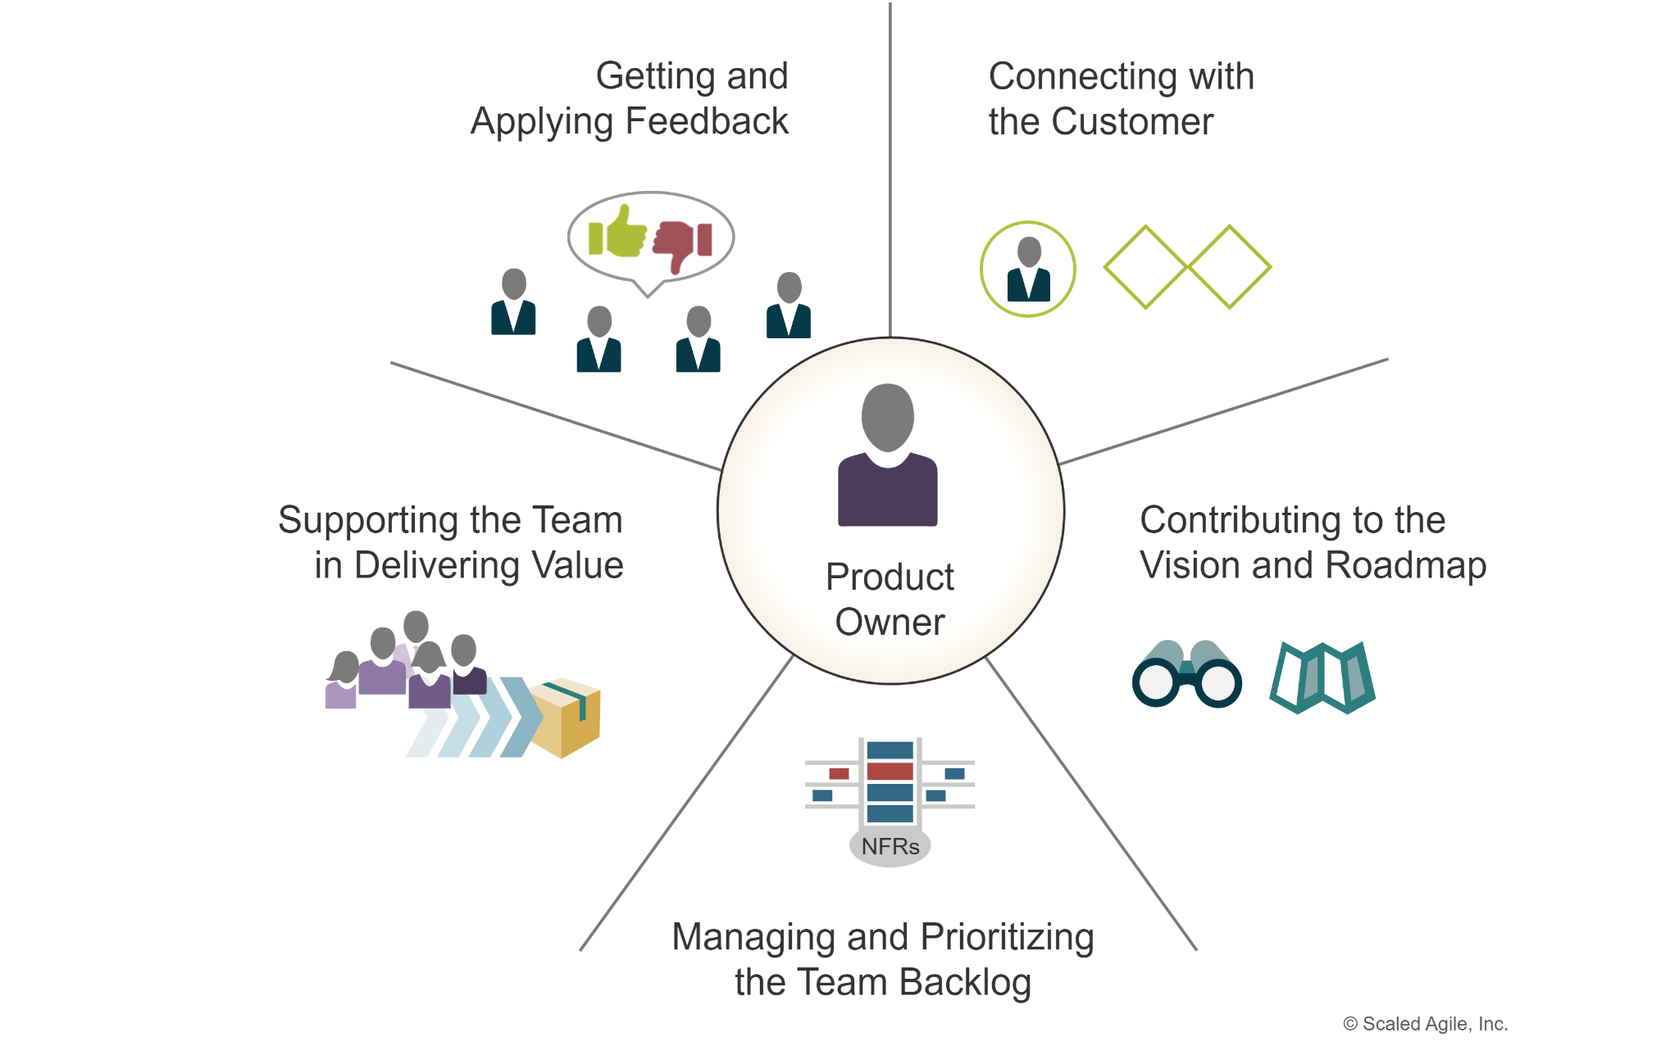
The Product Owner
The Product Owner helps to filter in which requests are coming from so that they can prioritize them using the product backlog.
They also help to relieve stress off a development team when they have to handle a multitude of objectives and tasks. (Kiiskinen, 2022).

Slide 4
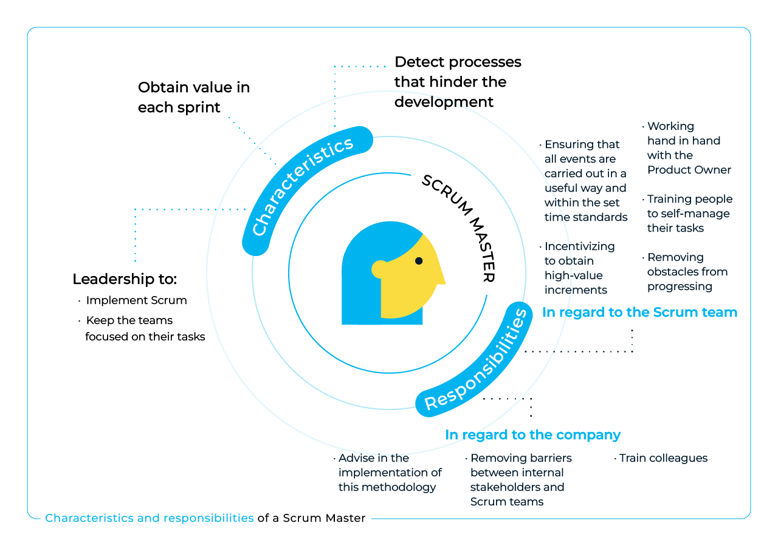
The Scrum Master
An article written by Moira Alexander explains, “The Scrum master not only addresses all facets of the agile development process but also serves the business, product owner, team, and individuals and facilitates communication and collaboration between all elements” (Alexander, 2023).
They can also act as servant leaders to help remove any other obstacles that may affect a team’s performance.

Slide 5
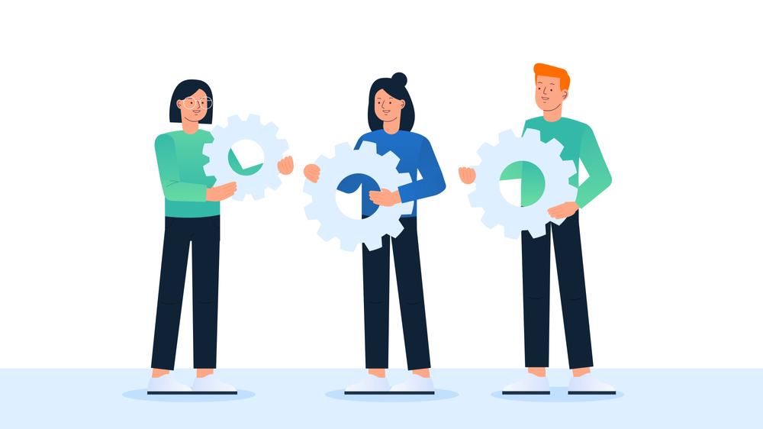
The Scrum Development Team
The developers have to be able to implement their own sprint cycles to be able to keep with a project’s progress (William-Jan Ageling).
Developers should be equipped to have the right tools and skills to be able to build the software framework for their future projects.

Slide 6
Explaining the Agile Phases
The Agile method breaks down the software development lifecycle (SDLC) into smaller sections called sprints. These phrases can range from sprint backlog to sprint retrospective. Sprint planning occurs when a whole team of developers sit down and discuss what requests their clients need and who is going to design and create the software foundation. The daily scrum are regular checkups used within the Agile approach. From there, review occurs, where the team presents their final product to their respective clients for review and deployment.

Slide 7
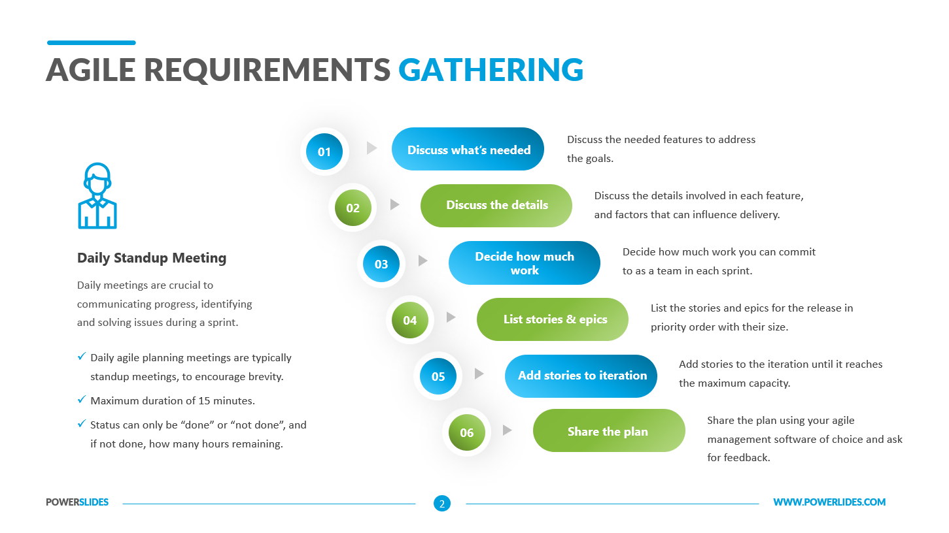
Phase One: Requirements Gathering and Analysis
This phase involves collecting high-level requirements, usually done through user stories to define what the end-user needs.
The approach focuses on the Agile method by capturing details of clients so that the development process can proceed further.
By the Product Owner, they determine the priority of these stories by the product backlog in order of importance.

Slide 8
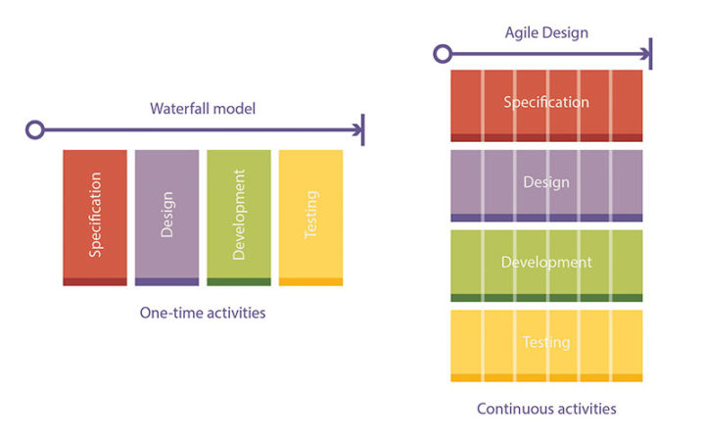
Phase Two: Design
This process is continuous in the sense that it is not a one-time event for developers.
For each sprint cycle, software developers focus on creating each fragment of software so that it is functional.
Significantly, collaboration between stakeholders and developers is crucial so that the final product is finalized for deployment.

Slide 9
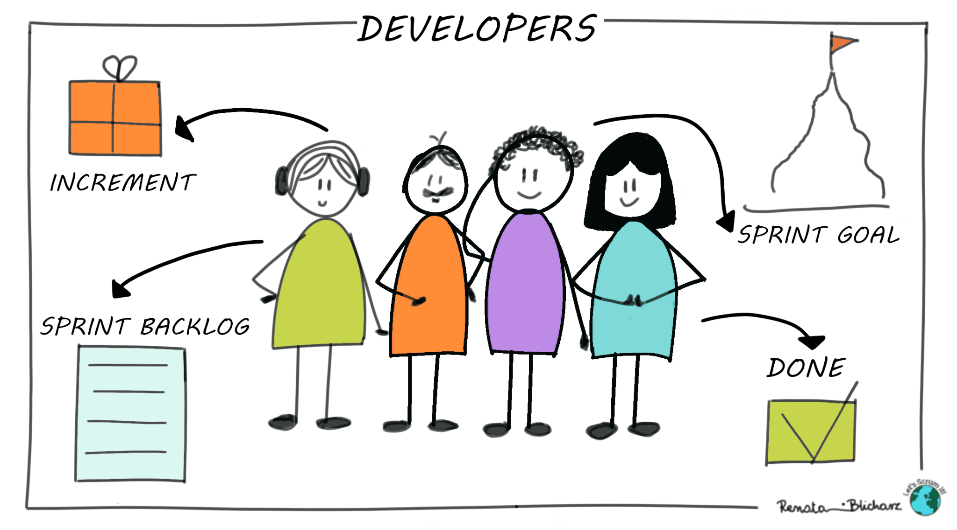
Phase Three: Development
In Agile, development is done typically in increments, so that there is no rush.
Each increment consists of developers completing a set of user stories within that sprint cycle so that it counts towards the end of development.
It emphasizes daily stand-ups, obstacle tracking, and plan adjustment for effective product making.

Slide 10
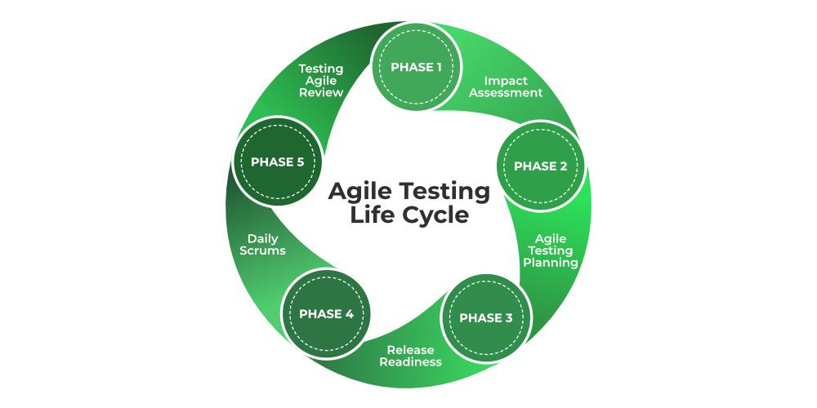
Phase Four: Testing
In accordance with development, when code is written by developers, it is then immediately sent to testers for them to deconstruct the code for any potential errors or bottlenecks.
Agile promotes and encourages automated, continuous integration so that software issues are caught early.
It helps to ensure that software bottlenecks are caught within each sprint, therefore reducing setbacks.

Slide 11

Phase Five: Deployment
Upon a team’s delivery cadence, software deployment usually occurs at the end of each sprint or release cycle.
Agile helps to correct this by enabling developers to release small update patches to consumers so that they can enjoy a seamless experience.
It also allows for feedback from customers so that developers can continue to tackle those issues.

Slide 12
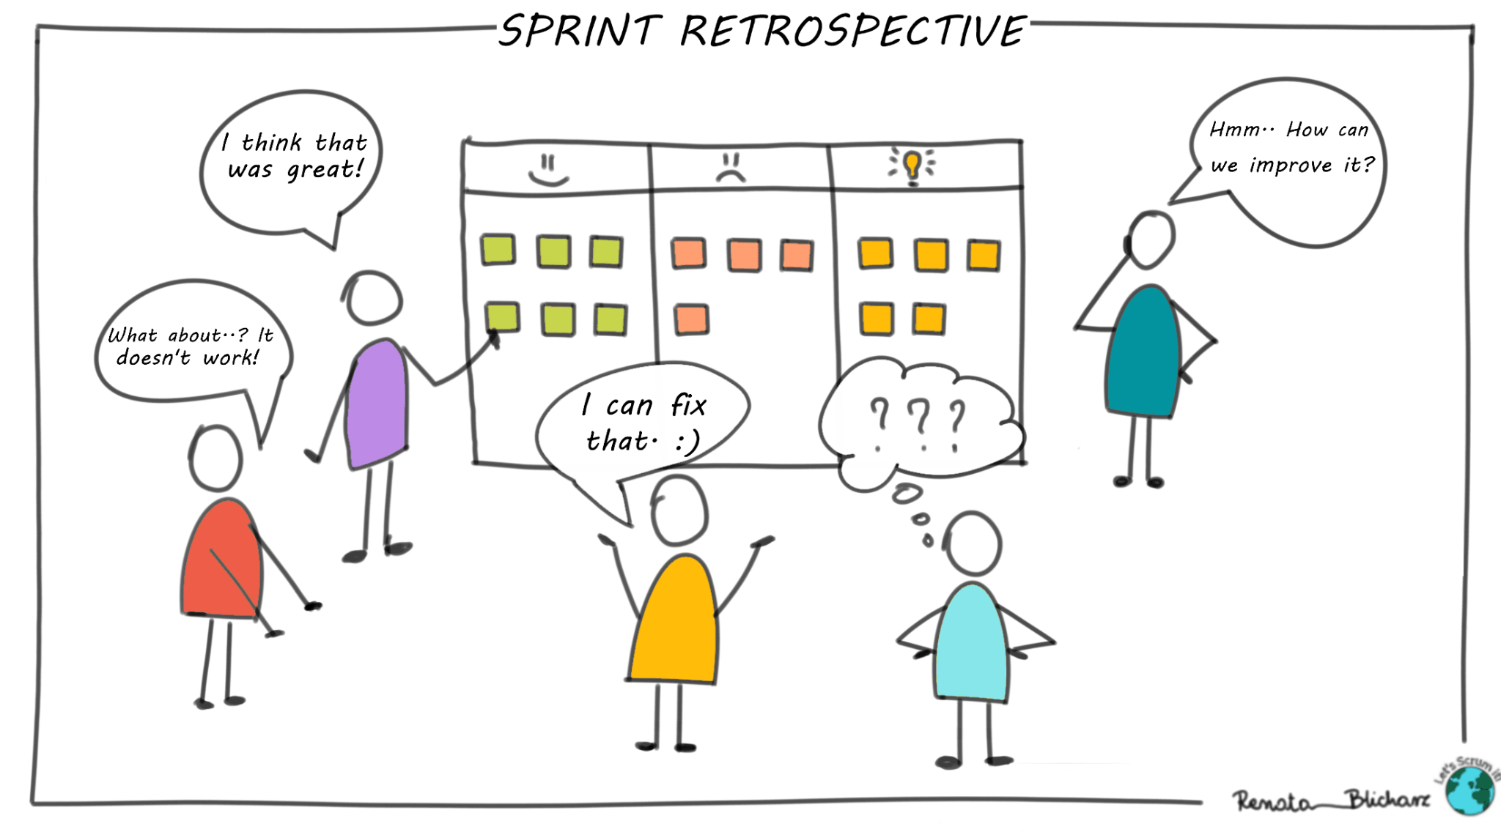
Phase Six: Sprint Retrospective
After each sprint, the team conducts a sprint review to discuss what they have done in regards to what has been completed, what errors have occurred, and what can be improved for the next sprint cycle.
It helps to keep alignment with customer values and needs. It promotes future team collaboration and the opportunity for new ideas to grow.

Slide 13
Describing the Waterfall Method
The Waterfall approach is a linear and sequential method in software development. Essentially, each phase must be completed before moving onto the next phase. On the contrary, Agile is an iterative cycle where it allows for continuous feedback and changes.
Had the SNHU Travel project been developed using the Waterfall method, it would have required an entire detailed analysis development phase that would take weeks to complete because of a concern for error. If changes had been made further down the line, then it would be cost effective for resources, investment from the clients, and a waste of time for the developers.

Slide 14
Waterfall or Agile Approach?
When deciding between the Waterfall or Agile approach, it’s crucial to know their differences in how they operate on a development scale. Both have their pros and cons, and this helps to distinguish them both and make a logical decision.
For the Waterfall method, Liz Lockhart writes, “While this approach is effective for straightforward projects that require minimal adaptation or creativity, it may not be suitable for more complex initiatives that demand a more flexible and dynamic approach.” (Lockhart, 2023).
In the Agile methodology, Liz Lockhart states, “Agile methodologies are about teamwork, customer satisfaction, constant refinement, and breaking big projects into bite-sized pieces. By prioritizing collaboration and communication, agile processes enable teams to pivot and respond to evolving customer needs while maintaining a high level of flexibility.” (Lockhart, 2023).

Slide 15
Time to Conclude
In conclusion, it all boils down to what suits the needs and wants of consumers, because they help to keep the market in check when it comes to different hubs of software. Yet, this is dependent on how efficiently development teams work together to achieve a vision, dream, or any other mission statement. It all comes down to the Agile methodology being the best choice because it allows for room for errors to be fixed while not having to worry about even the smallest errors in software development. Unfortunately, the Waterfall method fails to suit this pathway, as it does not support a learn-to-improve scope among team members. All in all, as many say, it is about quality over quantity.

Slide 16
References
Alexander, M. (2023, October 23). What is a Scrum master? A key role for project success. CIO; IDG.Inc.company. https://www.cio.com/article/230646/what-is-a-scrum-master-a-key-role-for-project-success.html#:~:text=At%20the%20product%20owner%20level
Arto Kiiskinen. (2022, March 8). Why you need a real Product Owner. Eficode.com; Eficode Oy. https://www.eficode.com/blog/why-you-need-a-real-product-owner
Lockhart, L. (2023, February 15). Agile vs. Waterfall: 10 Key Differences Between the Two Methods. Www.float.com; Float © 2024. https://www.float.com/resources/agile-vs-waterfall#:~:text=Delivery%3A%20Agile%20allows%20for%20quick
Willem-Jan Ageling. (2022, November 6). Let’s Discuss the True Meaning of the Term “Developer” in Scrum. Medium; Serious Scrum. https://medium.com/serious-scrum/lets-discuss-the-true-meaning-of-the-term-developer-in-scrum-907402c529a1#:~:text=They%20work%20together%20to%20create

